Slide 1
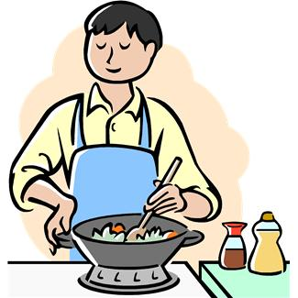
Setting up your gluten free kitchen
How to prevent cross contamination in your home

Slide 2
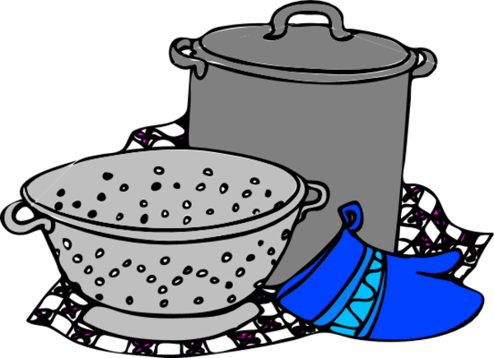
Sharing a kitchen with gluten eaters
Can be potentially dangerous to those with celiac disease or non celiac gluten sensitivity, hashimoto's/graves disease
Notes:
It is possible to share a kitchen, but everyone has to be on board and follow some strict rules to keep people safe. It is a microscopic amount of gluten that can make you sick. Sometime you will think that you have a better tolerance and a little seems okay. It may not be. Damage can be done with little symptoms that you know of.

Slide 3
Today we will discuss
Cross contamination
Sharing a Kitchen
Foods hiding gluten

Slide 4
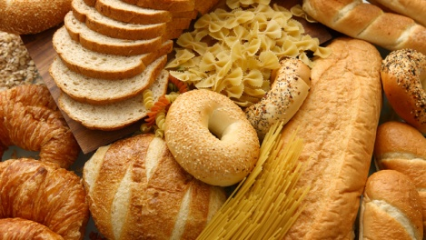
Understanding gluten
Gluten is a protein.
It is found in grains such as wheat, (wheat germ, wheat grass, wheat germ oil) rye, barley, kamut, spelt, triticale, graham flour, bulger, farina, couscous and semolina.
Oats and oat bran may be problematic as they can be cross contaminated with wheat.
Notes:
Gluten is what makes bread rise, it makes pizza crust crispy yet soft and chewy. It gives structure to baked goods. Take it away and from cakes will not rise. It thickens, flavors, and a host of other things. It is also very sticky which is the problem in shared kitchens.

Slide 5
Celiac Disease and Gluten Intolerance
These are autoimmune disorders. Both of these disorders cause damage to the small intestines and Celiac disease can be fatal if a strict gluten free diet is not maintained.
Symptoms are varied and misdiagnose can be common.
Symptoms include intestinal problems, migraine headaches, infertility, chronic anemia, obesity, arthritis, memory loss, psoriasis, eczema, IBS, low thyroid, chronic fatigue syndrome, type 1 or 2 diabetes, autism, fibromyalgia…
Adherence to a strict Gluten Free Diet necessary for their health!

Slide 6
Going Gluten Free
Limiting bread and cookies is not enough
You must completely avoid gluten and foods containing gluten ingredients
5 ppm is sometimes too much. The FDA allows 20 ppm to be called gluten free.
The safest foods are the foods that are naturally gluten free and are prepared in ways that prevent gluten contamination.
Notes:
Eating foods that are whole foods, beef, chicken, vegetables and fruit are naturally gluten free is best. The problem can be in the preparation. Battering and deep frying chicken tenders takes it from a safe food to a unsafe food unless you batter with gluten free flour blends and deep fry in gluten free fat, at home, where other foods are either not fried in that oil or fried after the gluten free food and then discarded.

Slide 7
What is cross contamination?
Cross contamination occurs when harmful bacteria or allergens spread to food from other food, surfaces, hands or equipment. It can occur if equipment used for raw food preparation is then used for cooked or ready-to-eat food. It can also happen when equipment is used when preparing a food allergen (or intolerance) and then the equipment is used to prepare food for someone that has an allergy or intolerance to that item.
Notes:
An example of this is that if I made peanut butter frosting in this mixer and then use the mixer to make chocolate frosting. Should the person eating the chocolate frosting have a peanut allergy, they will get sick and in some cases die and not know that the frosting was contaminated. This can also happen when we share peanut butter, mustard, ketchup, and butter.

Slide 8
Cross contamination
Cross contamination is a serious concern when living in a “blended” household.
A blended house is where one or more people in the house are not gluten free and others are.
In situations where the disease is sever, the household being gluten free is a real benefit to the one that is suffering with the illness.
!Cross contamination happens when a food that has gluten comes in contact with a gluten free food!

Slide 9
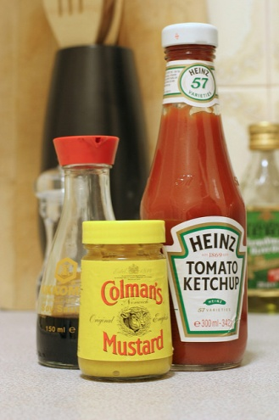
How does cross contamination occur?
Cross contamination can occur very easily in a blended household.
Butter, peanut butter, jelly, mustard, ketchup, are all areas of potential contamination if shared
Sharing utensils is not always possible.
Notes:
Story about Scott and the mustard. Butter sharing too.

Slide 10
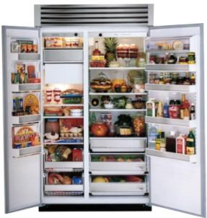
Storage of food matters

Slide 11
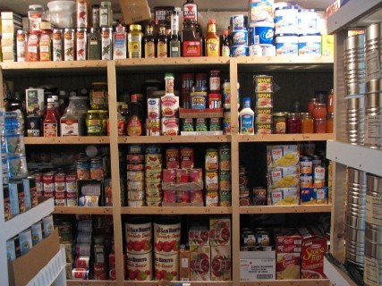
Gluten free on top!
Store your gluten free foods above foods that contain gluten so that crumbs do not fall and contaminate food.
Keep shelves clean
Store food containing
gluten in a separate cupboard
segregate them to avoid
accidents

Slide 12
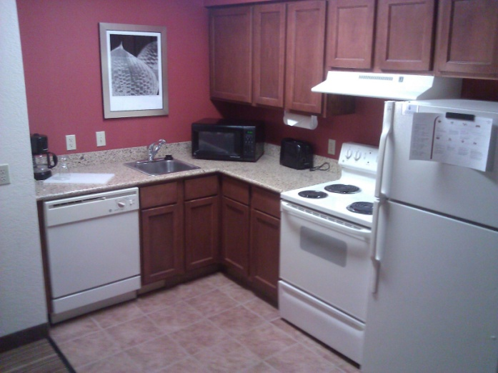
Separate Foods to be safe
Gluten containing foods and the tools used to cook them should be kept separate.
This helps to reduce accidents.
For youngsters, store gluten foods above their reach and out of sight.

Slide 13
Kitchen utensils and cutting boards
Sharing anything plastic, rubber, silicone or wood is dangerous!
Choose a color for gluten free safe foods.
Keep separate sponges for dishes
Wash gluten free dishes first-gluten is sticky!
Strainers should be separate too
Silverware, glass plates, glasses and stainless can be shared if washed carefully and sterilized.

Slide 14
Sharing a Refrigerator.
Top shelves for gluten free items. This way crumbs cannot fall onto the gluten free foods
Mark any potentially “shared” items with a black X if they become contaminated. Squeeze bottles are great, as long as no one contaminates them.
Everyone on board! Just a small amount is enough to cause problems. Crumbs in the peanut butter, touching the tip of the squeeze bottle of mustard to wheat buns… all are problematic.
Have separate gluten free condiments, labeled, if necessary.
Communication is essential! Mistakes happen, learn from them.
Notes:
Remember the mustard story.

Slide 15
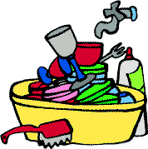
The Sink!
Yes, even the sink is a potential problem!
Keep separate sponges. Gluten is very sticky!
Keep separate scrubbies and do not store them together. Color coding works here too.
Should someone make a mistake, speak up! That way new sponges/scrubbies can be gotten so no one gets sick!
Keep separate towels for wiping dishes. Color code here too. Kitchen towels are used for many reasons; wiping hands, wiping counters, etc. Were those hands just eating a gluten hamburger bun?

Slide 16
Food storage.
Separate containers here too. Remember gluten is sticky, very sticky. Keep separate containers for left over's if necessary.
Store gluten free foods above foods containing gluten.

Slide 17
Appliances and Equipment
Some appliances are okay to share. The stove for example.
The toaster is not safe to share.
Non porous materials like glass, metal and pyrex are okay to share.
Plastic, vinyl and wood cannot be shared.
Non stick skillets and pans with scratches are not safe as gluten can get into the scratches and contaminate the food. These should not be used anyway.
Cutting boards should not be shared. Color coding works great. Have a specific color for gluten free cutting boards like other utensils.

Slide 18
Foods that are hiding gluten
Read labels!
Gluten is used for many purposes.
Thickening
Flavoring
Anti-caking agent
This makes it hard to find at times and can be listed as many different things.

Slide 19
Questionable ingredients
Along with having to watch for wheat and wheat derivatives, rye, barley, kamut, spelt, triticale, graham flour, bulgur, farina, couscous and semolina you have to watch out for:
Artificial color, caramel color, caramel flavoring, dextrins, dextrimaltose, emulsifiers, food starch, modified food starch, hydrolyzed plant protein, hydrolyzed protein, hydrolyzed vegetable protein, hydrogenated starch hydrolysate, hydroxpropylated starch, maltose, malt, miso, MSG, Natural flavoring, Natural flavors, Natural juices, non dairy creamer, pregelatinized starch, protein hydrolysates, smoke flavoring, soy sauce, soy sauce solids, stabilizers, wheat gluten and wheat starch.
Some of these contain gluten and some do not.

Slide 20
How to know?
When you see one of those ingredients on the
label…
Look for “gluten free” on the label.
Call or email the address on the packaging and ask if there is gluten in the item
Search the internet. Typing in the question is usually enough to get an answer.
Check a reference book for gluten free foods.
When in doubt, make another selection! Do not risk getting sick.

Slide 21
Sharing a kitchen
It can be tough
It is possible
Everyone has to be part of the solution.
Communication when accidents happen is essential
Notes:
It can be tough, that is true. However, if everyone is on board and communication is good, it can be possible

Slide 22
Questions?
Notes:
Does anyone have any questions

Slide 23
Kathy Babbitt President
The G.I.F.T. program from BABBITTS, INC. Uniting families around a healthy dinner table Living gluten free does not have to be challenging, overly costly or time consuming.
kathybabbitt@thebabbitts.net
www.thebabbitts.net
256-652-6056

