Slide 1
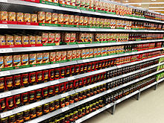
Shopping and gluten free
Learning to navigate the landmines on the grocery store shelves

Slide 2
Kathy Babbitt
President of BABBITTS, INC.
GIFT Program Helping people live gluten free
Classical Chef
Former Restaurant Owner and Manager
Gluten Free 11 Years

Slide 3
Where to start?
Today we will discuss
Safe foods
Safe cooking
Read labels
Easy rules to follow
This will give you a great start to getting your health back!

Slide 4
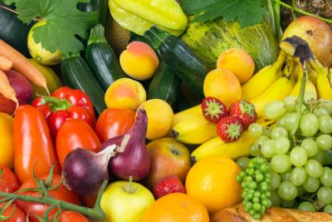
Choose wisely

Slide 5
Fruits and Vegetables
Fruits and vegetables and lagumes are naturally gluten free.
Fresh whole varieties are better
Preparation is the potential problem.
Avoid frying your vegetables, deep fried cauliflower is not a wise choice
Avoid gravy and sauces unless you are sure they are gluten free.
Steamed, sautéed, micro waved, or raw are healthy choices.

Slide 6
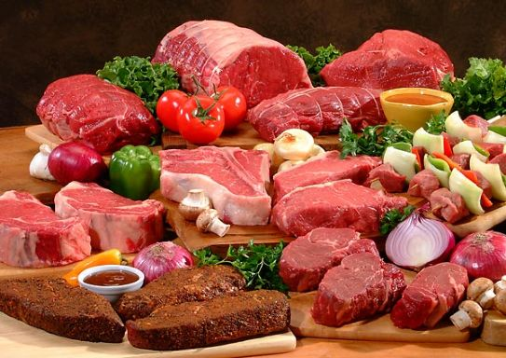
Meats
Whole muscle meats, chicken, fish and shellfish are naturally gluten free!

Slide 7
Naturally Gluten Free
Choose whole muscle meats. There are some sausages that are gluten free on the market, but watch ingredients.
Do not assume that frozen burger patties are gluten free, some have fillers that are wheat.
Buy fresh when possible, not frozen.
Choose cooking style that are healthy. A chicken tender is gluten free until it is battered.

Slide 8
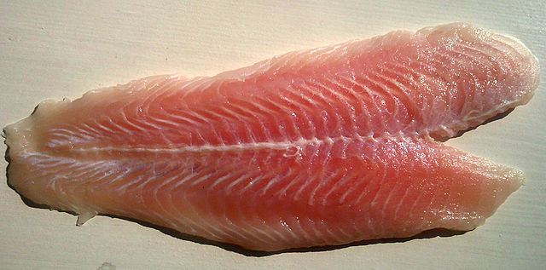
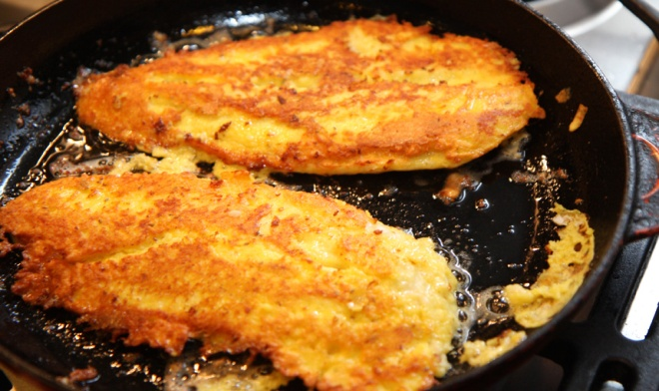
Fish and Seafood
Fish and Seafood are naturally gluten free. The cooking can be the issue…

Slide 9
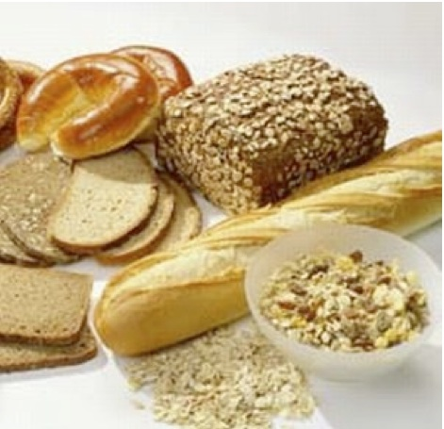
Whole Grains
Whole grains are very important to our diets.
The USDA suggests that half of our grains are whole grains.
Corn
Quinoa
Wheat
Wild rice
Cereals, popcorn
Whole grain breads and pastas

Slide 10
Grains and Gluten Free
This is where we have to be careful
Some grains have gluten
Gluten is a generic name for a certain types of protein that is in some grains.
It is what make the bread crusty and chewy, make pizza crust chewy and makes pastries flaky.
Gluten can be hidden in other foods making it difficult to find.

Slide 11
Gluten Grains
Gluten is in grains like wheat, barley, rye, spelt, kamut and triticale.
The USDA requires labeling for the 8 top food allergies on the labels of foods
Eggs, milk, fish, crustacean shellfish, tree nuts, peanuts, wheat and soybeans
Gluten is not required to be listed on labeling.

Slide 12
On August 5, 2014 the FDA adopted a voluntary gluten free labeling policy.
Manufactures can label gluten free if product has less than 20 ppm of gluten.
Any food product conforming to the stand may be labeled gluten free even if it is naturally gluten free.
Manufactures do not have to label. It is voluntary.

Slide 13
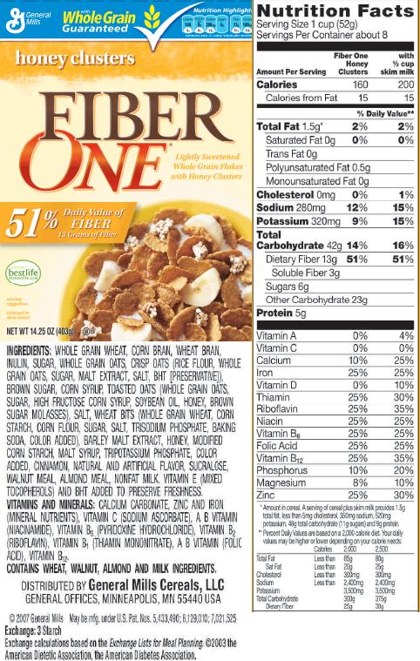
Read Labels.

Slide 14
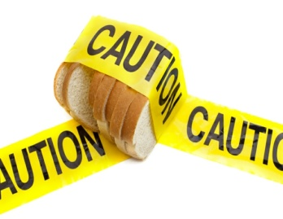
Gluten is used in may products
Read Labels
Know what names gluten goes by…
It is not always obvious
Gluten can be found in lost of different products you would not expect like twizzlers, tomato soup, mustards, soysauce, soups and stocks!

Slide 15
Watch for…
Wheat, oats, Barley, Triticale, Rye. Spelt
Also known as…wheat starch, hydrolyzed wheat protein, wheat germ, malt, flour, semolina, bulgur, durum, frumento, graham, kamut, farina, einkorn, seitan. Couscous, matzah cake flour, modified vegetable starch…

Slide 16
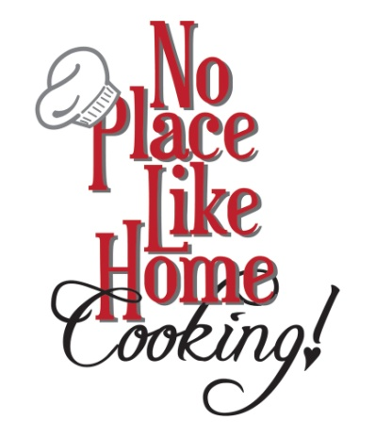
What do you do?
Easy Rules
Eat fresh whole foods
Fresh vegetables and fruits are naturally gluten free
Poultry, fish, beef, pork and seafood are naturally safe
Avoid prepackaged foods when possible
Learn to cook!
The best way to be safe is to make
your own baked goods
Make your own casseroles, lasagna,
and other favorites!

Slide 17
Uniting Families around a healthy dinner table.
In conclusion
Your safest with whole fresh foods that are prepared in a safe manner. Grilled, sautéed, baked and broiled are safe; avoid deep fried unless you know it is a dedicated fryer.
Avoid prepackaged foods unless they have gluten free printed on the packaging.
Learn to cook. It can be a great family activity! Watch your own ingredients too. Gluten is hiding in places that you might not expect.
Living gluten free does not have to be overly costly, time consuming or challenging.

Slide 18
Questions?
Thank you for coming!
Kathy Babbitt
kathybabbitt@thebabbitts.net
www.thebabbitts.net

