Slide 1
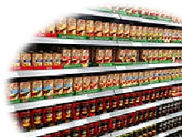
Gluten Free on a Budget
Controlling costs

Slide 2
Kathy Babbitt
President of BABBITTS, INC.
Author Loving Living Gluten Free
GIFT Program Helping people live gluten free
Classical Chef
Former Restaurant Owner and Manager
Gluten Free 11 Years

Slide 3
Where to start?
Today we will discuss
The cost associated with gluten free shopping
Why is gf more expensive
Where to shop
Stocking up!
shopping
Safe foods
Read labels
Easy rules to follow
This will give you a great start to getting your health back!

Slide 4
Cost of Gluten Free
It can be a lot more expensive!

Slide 5
Why does it cost so much?!?
Pre packaged foods are more expensive because you are paying for convenience
Gluten free foods have more ingredients. Additional foods have to be added to make up for what gluten does. Gums, different flours, moisture and seasonings
Processing! GF has to be transported, processed and packaged separate from gluten foods
Supply and demand and trendy

Slide 6
Pre Planning
Write a menu for the week or month and then shop the menu.
Inventory what you have. Use what you have on hand left from last week to make the menu, reducing throwing away foods
Write the menu for the month. Should you be able to do this, you can buy larger quantities at a box store and freeze for later in the month. This makes it possible to take advantage of sales throughout the month, but not just buy because it was on sale…
Buy in bulk on line at sources like Amazon
Notes:
Living alone? Make the full batch and then freeze the additional portions for later. You could cook one week and make enough for a month! For variety, cook during the month and save the leftovers…

Slide 7
Shop Around
High end grocery stores are not the only source of GF foods.
Alde's, Kroger's, Publix, Walmart
Same brands, just cost less than at the Organic Grocery Stores
Buy larger quantities at stores like SAM’s and freeze food for use later
Farmers Markets- vegetables can be frozen too! Just blanch them first and into the freezer they can go…
Get a good shopping guide for reference and use it when making your grocery list.
Buy on line. GF flours can be a lot cheaper on Amazon…
Notes:
The peanut butter story here. Also introduce the shopping guides that I have for sale

Slide 8
Buy Local!
The best foods are foods in season in your area.
Not picked early for shipping
Farmers Markets are great sources for local foods
Local farms and butchers for local meats
Go in with a family members and friends and buy a side of beef and freeze it
Do your homework to make sure that they are raised as you prefer
Eat better, not more. Buy better meat and eat less, eat more vegetables to fill up!

Slide 9
Pre packaged foods
Paying for convenience and then throwing it away!
Prepackaged foods cost more.
Throwing out an average of 25% of our food, with the additional expense GF foods, that can add up fast!
Make your own convenience foods when cooking
Preplanning
Freezing leftovers
Saves money and time later when you are running late
Notes:
This is great for small families and those living alone. Make for 4 and freeze individually for dinners in the future.

Slide 10
Shopping GF
Choose naturally gluten free foods

Slide 11
Choose wisely
Notes:
Shop the perimeter of the store. The produce department, dairy department, seafood and meat departments. Some exceptions like Sprouts and aldes that have the produce in the center of the store. The principles are the same.Natural whole foods are gluten free. Vegetables, fruits, nuts, whole muscle meats, fish and seafood and some whole grains are naturally gluten free

Slide 12
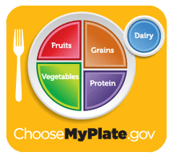
Choose My Plate
Government website for healthy eating and lifestyle
https://www.choosemyplate.gov/MyPlate
https://www.choosemyplate.gov/MyPlate-Daily-Checklist
My Fitness Pal
Fitness Tracker Aps

Slide 13
Eating Healthy & Eating Gluten Free can be one in the same
Eating healthy is increasing fresh fruits, vegetables, Grains (GF), Fish and seafood (as long as not allergic) and eating lean meats.
All of those are naturally Gluten Free.

Slide 14
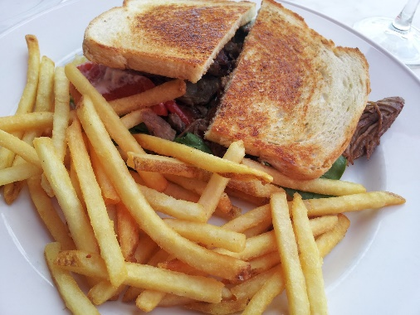
Not heathy anyways…
Not heathy… cakes, cookies, candies, battered deep fried foods, lunch meats, cheese food products, full fat mayonnaise (sandwiches)…
Gluten Free breads and cookies have more calories and a higher glycemic index than the glutinous ones!
Skip or limit those foods
and you will be on your way
to better health.

Slide 15
Organic vs Non Organic
This is a very personal choice
Economically difficult
What to choose when you cannot afford only organic
The dirty dozen
The clean fifteen
Meats
Fish and seafood
Wild caught
Cold waters
Notes:
I get asked this a lot. Lets take a moment to do a brief overview…

Slide 16
Dirty Dozen
Strawberries
Apples
Nectarines
Peaches
Celery
Grapes
Cherries
Spinach
Tomatoes
Sweet bell peppers
Cherry Tomatoes
Cucumbers
Hot Peppers
From EWG’s shoppers guide to pesticides in produce

Slide 17
Clean Fifteen
Avocados
Sweet corn
Pineapple
Cabbage
Sweet Peas (frozen)
Onions
Asparagus
Mangos
Papayas
Kiwi
Eggplant
Honeydew Melon
Grapefruit
Cantaloupe
Cauliflower

Slide 18
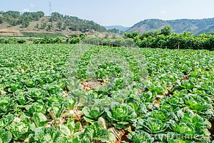
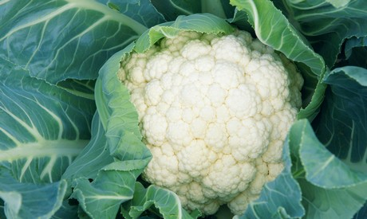
Cauliflower
Growing
Ripe
Notes:
The common denominator in the clean 15 is that most have a skin that you do not eat… like the outer portion of the pineapple. That is a natural defense for the fruit but also, any pesticides used (because not organic) will be washed off before cutting/eating.

Slide 19
Fruits and Vegetables
Fruits, vegetables and legumes are naturally gluten free.
Fresh whole varieties are better
Preparation is the potential problem.
Avoid frying your vegetables, deep fried cauliflower is not a wise choice
Avoid gravy and sauces unless you are sure they are gluten free.
Steamed, sautéed, microwaved, or raw are healthy
choices.

Slide 20
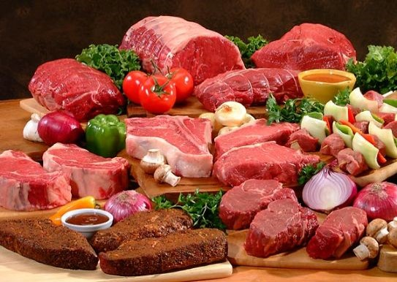
Meats
Whole muscle meats, chicken, fish and shellfish are naturally gluten free!

Slide 21
Organic Meat from Chris Kresser.com
The USDA organic livestock must have year round access to the outdoors except in bad weather.
They must be managed without antibiotics. This does not mean that the farmer is not to treat sick animals.
They cannot have been given growth hormones and cannot be given prohibited food, such as animal byproducts, urea and arsenic compounds.
They must graze on land that is certified Organic. The feed must also be certified 100% organic.
Grazing animals (Cows, Sheep, Goats) must have access to organic pasture and 30% of their diet must come from this organic pasture.
Notes:
Soybean meal is another feed that is given a negative UFP value. The negative UFP value of soybean meal is caused by the large nitrogen release in the rumen with this feed because of the high solubility and high percentage of protein in soybean meal. Urea can replace the cost of beef cattle rations. In some experimental comparisons urea has reduced fee cost by 1 cent for each pound of beef gain or a total of $4 -$6 a steer. Urea has a protein value in a beef ration, but it does not furnish energy, vitamins or minerals.

Slide 22
Health Benefits
Fats: the amount of saturated fat was similar, but the monounsaturated fats were a little less in organic meats. The Omega 3 fatty acids were 47% higher in organic meat.
In dairy, organic dairy was found to have lower iodine and selenium levels, higher iron and vitamin E.
Antibiotics in chicken made them grow larger. However, they have reeked havoc on our gut bacteria. The antibiotic that makes a chicken fat…can make us fat too. The antibiotics in the chicken get into their muscle and then the make their way into our bodies.

Slide 23
Naturally Gluten Free
Choose whole muscle meats. There are some sausages that are gluten free on the market, but watch ingredients.
Do not assume that frozen burger patties are gluten free, some have fillers that are wheat. Leading brand name patties use bread crumbs!
Buy fresh when possible, not frozen.
Choose cooking style that are healthy. A chicken tender is gluten free until it is battered with flour and fried in shared oil...

Slide 24
Fish and Seafood. Wild vs Farm From Mayo Clinic by Jennifer K Nelson R.D., L.D
Wild caught:
Increased levels of mercury, pollutants, pesticides and fertilizers in the food
Fishing practices can be hard on the environment
Farm raised fish are not all created equal.
Choose from stores and suppliers that you trust
Choose from countries that have strict laws in place for farming
Cold water farming is different than warm water farming. Ocean Farming is different than fresh water.
Farming can be bad on the environment too.
Notes:
Warmer waters grow bacteria. Farm raised cold water fish like halibut, salmon, Cod, Orange Roughy. Tuna, herring, Mackerel, SardinesWarm water fish are talipia, large mouth bass, Crappie, Catfish,

Slide 25
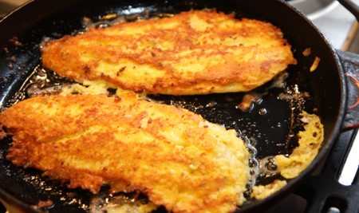
Fish and Seafood
Fish and Seafood are naturally gluten free. The cooking can be the issue…

Slide 26
Whole Grains
Whole grains are very important to our diets.
The USDA suggests that half of our grains are whole grains.
Corn
Quinoa
Wheat (we cannot have)
Wild rice
Cereals, popcorn
Whole grain breads and pastas (we cannot have these either)

Slide 27
Grains and Gluten Free
This is where we have to be careful
Some grains have gluten
Gluten is a generic name for a certain types of protein that is in some grains.
It is what make the bread crusty and chewy, make pizza crust chewy and makes pastries flaky.
Gluten can be hidden in other foods making it difficult to find.

Slide 28
Gluten Grains
Gluten is in grains like wheat, barley, rye, spelt, kamut and triticale.
The USDA requires labeling for the 8 top food allergies on the labels of foods
Eggs, milk, fish, crustacean shellfish, tree nuts, peanuts, wheat and soybeans
Gluten is not required to be listed on labeling.

Slide 29
Gluten Free Labeling
On August 5, 2014 the FDA adopted a voluntary gluten free labeling policy
Manufactures can label gluten free if product has less than 20 ppm of gluten.
Any food product conforming to the stand may be labeled gluten free even if it is naturally gluten free.
Manufactures do not have to label. It is voluntary.

Slide 30
Read Labels.

Slide 31
Gluten is used in may products
Read Labels
Know what names gluten goes by…
It is not always obvious
Gluten can be found in lost of different products you would not expect like twizzlers, Pringles potato chips, tomato soup, mustards, soy sauce, soups and stocks!
Seasonings. Check seasoning mixes (taco, chili, shaker blends too )
Gluten is also found in some whole turkeys, Chickens and hams…

Slide 32
Watch for…
Wheat, oats, Barley, Triticale, Rye. Spelt
Also known as…wheat starch, hydrolyzed wheat protein, wheat germ, malt, flour, semolina, bulgur, durum, frumento, graham, kamut, farina, einkorn, seitan. Couscous, matzah cake flour, modified vegetable starch…

Slide 33
What do you do?
Easy Rules
Eat fresh whole foods
Fresh vegetables and fruits are naturally gluten free
Poultry, fish, beef, pork and seafood are naturally safe
Avoid prepackaged foods when possible
Learn to cook!
The best way to be safe is to make
your own baked goods
Make your own casseroles, lasagna,
and other favorites!

Slide 34
Uniting Families around a healthy dinner table.
In conclusion
You are safest choosing whole fresh foods that are prepared in a safe manner. Grilled, sautéed, baked and broiled are safe; avoid deep fried unless you know it is a dedicated fryer and you are using a gluten free flour.
Avoid prepackaged foods unless they have gluten free printed on the packaging.
Learn to cook. It can be a great family activity! Watch your own ingredients too. Gluten is hiding in places that you might not expect.
Living gluten free does not have to be overly costly, time consuming or challenging.

Slide 35
Questions?
Thank you for coming!
Kathy Babbitt
kathybabbitt@thebabbitts.net
www.thebabbitts.net

