Slide 1
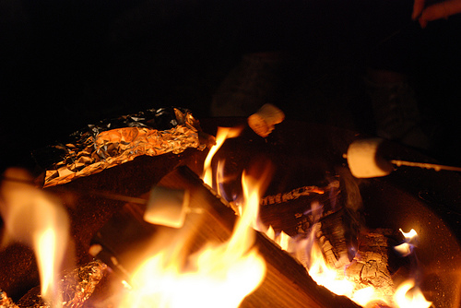
Bring On Summer!
Enjoy Gluten Free Graham Crackers & S’mores once again
Notes:
Hi, Welcome To this class.
Today we will make graham crackers
Talk a little bit about history
And we will make s’mores… remember with the marshmallows will be hot and please no children around the open flame.
Okay (change slide)

Slide 2
Kathy Babbitt
Classical Chef & Author
President of BABBITTS, INC.
Notes:
I am Kathy Babbitt. I am a classical Chef, author of Loving Living Gluten Free Recipes that work cookbook and the President of BABBITTS INC, which has a program called the GIFT program, Gluten Intolerance food training,
and one of its goals is to educated people on living gluten free.
I do that one on one and in classes like this one.
This is my husband Scott, he is the financial officer of the company and is graciously helping with the presentation today
We are thrilled to be here with you today.

Slide 3
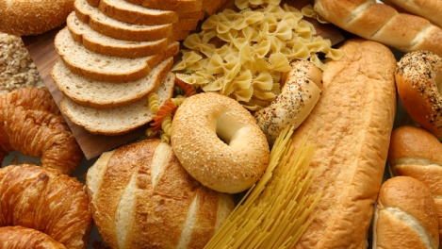
My Story
I miss wheat.
I have Hashimoto’s disease
I have been living gluten free for 12 years
It has not been easy
Now I try to take what I have learned and help others to normalize their lives
Notes:
Let me just say that I miss wheat. I really miss wheat
Before finding out I had to live gluten free we owned an Italian restaurant, Pizza, pasta… I loved it all. Bread was my favorite food group
I have Hashimoto’s though and like so may others I was not even aware that I had to live gluten free. I was treated for a lot of different illnesses before finding out that gluten was the cause of all the ailments
I have been on this journey for 12 years. It has not been easy. Like everyone, there have been ups and downs.
Now I try to help others learn to live gluten free using the lessons that I have learned along the way

Slide 4
Missing a normal life
Living a in a blended household is difficult
Knowing what to buy at a store is confusing
Conflicting information on the web is frustrating
Notes:
It is hard not to miss a normal life.
Living in a blending home can be challenging. I work with families and individuals on avoiding cross contamination in the home and helping them find solutions to everyday challenges.
Knowing what to buy in the store can be difficult. There are lots of GF products out there and labeling is getting better, but we are still spending more money at times than we need to. Jam is a great example. I have clients that buy expensive jam that say GF on the label and they are on the shelf next to Smucker and many store brands that are Gluten free and they do not know it.
Then there is the information on the internet. It can be conflicting and confusing. Standing in the grocery store isle, googling “is it gluten free” and getting conflicting information on the internet is frustrating… it can be hard to find the manufacture site and get the answers you need.
It is getting better, but it call all lead to frustration. It can be hard to know what to believe

Slide 5
Going Gluten Free
Limiting bread and cookies is not enough
You must completely avoid gluten and foods containing gluten ingredients
The FDA allows 20 ppm to be labeled GF. For some that are very sensitive, that can be too much. Know your own limits.
The safest foods are the foods that are naturally gluten free and are prepared in ways that prevent gluten contamination.
You still want to feel normal in all this confusion; children want to participate in normal activities with other children
Notes:
We know that limiting is not good enough. There is no cutting back for us.
We must completely avoid gluten. Period.
We know that the safest foods are foods that are naturally gluten free, made without adding gluten or cooking with gluten and made in a way that avoids cross contamination. A chicken breast is gluten free, adding gluten bread crumbs and frying with gluten onion rings…that is a problem.
How can we bring some normalcy back into our lives. How can we help our children participate in actives with other children without having to have “special” foods others are not eating?
I hear so many complaints from gF and Gluten eaters alike trying to merge the two

Slide 6
What if there was another way
There are foods that you can make with just a few ingredients that people will not know are gluten free
Imagine a life where you do not have to be different…
Imagine sending cake to school for your child's birthday that everyone can enjoy!
Notes:
There are times that we can have a little normalcy in our lives and not just at home.
There are foods that we can make with easy to find ingredients that everyone can enjoy. I make a texas sheet cake that a friend buys when she needs a dessert for a party. She bought it once for here daughter who is GF and she bough a publix cake for everyone else. The texas sheet cake was devoured and the publix cake went uncut. Imagine a life where you can bring food to a work or family function that everyone enjoys while it is gluten free…
Imagine sending treats to school for your childs class function that all the kids love and he doesn’t have to eat a pre packaged food that is different than the rest of the class… not that having treats your child can eat while the other kids are eating something they cannot is bad, it is a great idea… but what if they could all eat the same food and like it

Slide 7
Today we will do that!
With summer and campfires nearly here, I will show you how to make your own gluten-free graham crackers and start enjoying s'mores again!
These wonderful, easy-to-make treats can be enjoyed by gluten-free and gluten eaters alike.
Notes:
Today we will tackle a summer favorite. We will make graham crackers for s’mores. They are not just for s’mores… they are great with Nutella, plain or crushing for a graham cracker crumb pie crust!
the recipes are here for those that want them

Slide 8
Gluten free graham crackers
½ cup KGGF (3/4 cup for crunchy crackers)
½ cup sorghum flour
½ cup millet flour
1 ½ teaspoon xanthan gum
½ cup brown sugar (firmly packed)
½ teaspoon baking soda
½ teaspoon salt
¼ cup butter
2 tablespoons milk
3 tablespoons raw honey
1 tablespoon vanilla
¼ teaspoon cinnamon (optional)
Heat the oven to 300°F.
Combine flours and xanthan gum, baking soda and salt and cinnamon (if using) in the bowl of a stand mixer and whisk to combine. Stir in the brown sugar, making sure there are no brown sugar lumps remaining. Break up brown sugar balls with the whisk or a fork.
Cut the butter into chunks. Turn on the mixer and add the butter, one chunk at a time. Mix until small clumps form. Turn off the mixer
In a small bowl, mix the milk honey and vanilla. Turn the mixer back on and add the liquid ingredients. Mix until well incorporated.
Notes:
Here is the recipe. There is dairy in this recipe, though you can use a dairy substitute if you want. Todays do have dairy though.
Lets get started.
Advance when I go over the ingredients

Slide 9
Working with gluten free flours
GF Flours are different and have different idiosyncrasies
The most important is the absorption of moisture
Knowing which works for what is important
You cannot over mix GF flours
You can incorporate too much air in them
Notes:
While mixing I will talk about the flours
When working with gluten free flours, you have to handle them differently
The main difference is the absorption of moisture
You have to give the flour some extra time to absorb the moisture or it will be grainy. You have to let it stand. There are some other ingredients that help with that, coco for example and oatmeal. As a general rule though, let the batter stand
The different flours have different best uses too. I have millet flour in her too. Yes this is the same millet grain that you feed the birds. Millet flour stays flaky. It is great in pie crusts because it adds to flakiness.
You cannot over mix GF flours. Overmixing has to do with gluten development. When making cookies for example, you add the flour last and mix just intil incorporated. When making bread with wheat flours, you have to mix longer and then kneed the dough. That is to develop the gluten strands. With Gf flours, there is no gluten.
You can incorporate too much air into the mix and the gums may not be able to hold the air. But you cannot “toughen” the dough as you can with gluten flours.

Slide 10
Lay a piece of parchment paper on a clean counter and then turn the dough out onto it. Cover with a piece of plastic wrap and use a rolling pin to roll the dough out about ¼ inch thick. Roll the length first, and then roll the width. About 10 inches wide and about 24 inches long. The size will depend on how thick you want the crackers to be. Transfer to a cookie sheet by lifting the parchment onto the cookie sheet. Trim the parchment to fit into the pan. Score the dough into cracker shapes, do not cut all the way through. Squares about 2 ½ inches area good size. Prick the top with a fork
Cook in oven for approximately 25 minutes at 300°F then check the crackers. Turn the pan and then cook for an additional 10-15 additional minutes at 375$°$F until done. They should be lightly browned. Cooking them for 35 minutes (depending on size, total cooking time) will produce a softer cracker, cook for 40-50 minutes total for a crispy cracker. The cooking time will depend on the thickness. Should you want a thinner cracker, less cooking time will be needed.
Cool and enjoy!
Notes:
I will say something on the process then advance

Slide 11
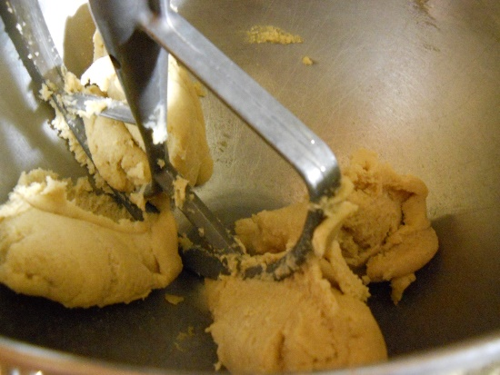
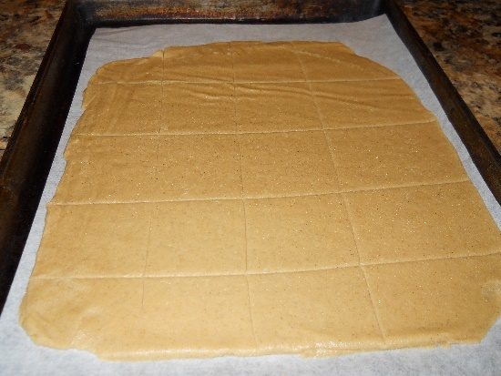
Making graham crackers
Notes:
Just post for a second and advance

Slide 12
The history of graham crackers
What we know as graham crackers are not historically correct
Original was a “health food”
What is graham flour
Developed by Rev. Sylvester Graham (7/5/1794-9/11/1851)as an alternative to the newly manufactured white flour
To make, the endosperm of winter wheat is finely ground then the bran and germ layers are returned and mixed in. This resulted in a coarse, brown flour with a nutty sweet flavor.
Notes:
Talk while rolling the dough…
The history of Graham crackers is interesting.
What we know of as graham crackers is not actually historically correct…
It was actually a health food. There was a minister, rev. Graham that believed that an unhealthy not only lead to an unhealthy body, but also an unhealthy mind. He believed that unhealthy eating lead to people giving into their carnal urges, general evils and obsessions. He was a Presbyterian minister and a dietary reformer. He had quite a following and he stressed a pure vegetarian diet and healthy whole foods. Interesting, we are still trying to get people to eat whole foods and this was the 1800’s , not a lot has changed.. He was part of the temperance movement
Anyway, Refined flour had been developed and processed bread starting showing up in stores and less and less was make in the home. His concerned him greatly. The original graham bread was dense and nutty and looked like this,
Advance slide

Slide 13
Graham bread

Slide 14
Original graham crackers
Started showing up in cookbooks in about 1882, but some experts believe that Rev. Graham developed the recipe earlier in 1829.
They were originally name graham crackers because they were made with the un-sifted wheat flour that he promoted.
Notes:
The original graham crackers started showing up in cookbooks in 1882. but some believed that the original was developed by Rev Graham in 1829. The belief is that the original used the graham flour. It is not at all likely that the original was a crisp sugary treat!

Slide 15
What we know as Graham Crackers
Nabisco brought us what we know as graham crackers.
1898 National Biscuit Company (now Nabisco) introduced a line of graham crackers then later in 1925 with the honey Maid Line.
Todays graham crackers are made with bleached flour, exactly what the original was trying to fight against!
Notes:
The national biscuit company which is not Nabisco, introduced a line of graham crackers in 1925 and then cmae out with the honey made line later. The honey made line was very successful. The graham crackers of today are made with the refined flour that Rev. Graham was so against.
Bring out graham crackers that are cooked and ready to try

Slide 16
Marshmallows
Original marshmallow was a healthful all natural preparation.
It was a swamp plant that resembled a hollyhock in Europe and west Asia.
The roots produced a sticky white sap
It was originally used medicinally as a sore throat cure
In the middle ages, chunks were candied to make “suckets” which were the medieval cough drop.
Notes:
So, these are the graham crackers that are done. I made them and then vacuum sealed them, it worked really well…
But sense we are making s’mores, we need marshmallows.
This is another food that is very different than it started!
Marshmallows were a cure for sickness…
The original marshmallow was a swamp plant that looks kind of like a hollyhock that was native to west Asia and Europe. Its roots produce a sticky white sap that was used medicinally for centuries.
In Egypt, over 2000 years ago they candied the root to make a delicacies for their gods, nobility and pharaohs. They mixed the mallow sap, honey and grains and baked it into a cake.
They also brewed mixtures of the plant sap and believed it cured sore throats and pains
It was almond Hippocrates medical treatments.
In the 15th and 16th centuries it was used for just about everything. Toothaches, coughs, sore throats, diarrhea and stomach aches. It was even used as a love potion.
In the middle ages, they would candy chunks of the roots to make a little medicine that was like a cough drops that people could suck on for a sore throat.

Slide 17
Next comes the french
In the mid 1800 the French turned marshmallow sap into a sweet treat. They whipped it into a meringue like foam with egg whites and corn syrup (or sugar) and poured it into a mold to form a fat, spongy confection that was a airy toffee like candy.
They were labor intensive and expensive.
Wealthy only enjoyed these sweet treats
Notes:
In the mid 1800”s French shop owners discovered that cooking and whipping marshmallow sap with egg whites and corn syrup and molding then molding them into little candies make a wonderful delicacies.
They are very expensive to make and only the wealthy could enjoy them

Slide 18
Then the invention of gelatin
By the late 1800 the marshmallow was replaced by gelatin which had become more available.
Marshmallows are half air. The gelatin keeps the are suspended and keeps the marshmallow fluffy.
This reduced production time, the gelatin was less expensive and labor reduced
Now, the new marshmallows could be enjoyed by more people.
Notes:
With the wide spread availability of gelatin the mallow was replaced by gelatin. By replacing the mallow these treats became more airy and could hold their shape. In 1954 the process was further streamlined and what we now know as the marshmallow got its shape.
Now the process was easier and less labor intensive.
This reduced the price greatly so they could be available to everyone and not just the wealthy.

Slide 19
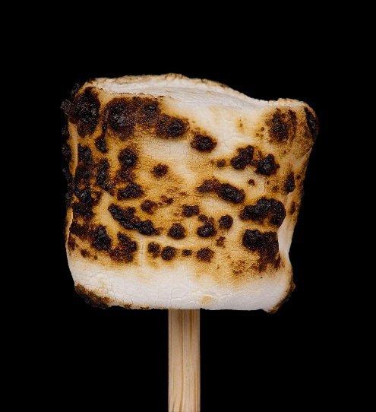
Marshmallows become a social phenomena
By the endo of the 1800’s marshmallows had become a social campfire fad
The simplicity was part of the charm
Sharing marshmallows was a flirtatious act
The ability to master the “toasting” was worthy of boasting
Notes:
Though the shape and processing was years away, by the end of the 1800, they make their way into the campfire scene. They were easy.
A stick and a marshmallow and you had a great treat that was really social too.

Slide 20
S’mores
Some Mores first showed up in a cookbook in 1927, “Tramping and Trailing with the Girl Scouts.
Loretta Scott Crew is given credit for the recipe.
Recipes for “Some Mores” continued in girl scout cookbooks until 1971, so it is not know when the name was shortened to S’mores.
Notes:
The s’mores history seems to begin in 1927 in a publication called tramping and trailing with the girl scouts. Actually my first experience with s’mores was at a girl scout camp when I was a child. Loretta scott crew is credited wit a recipe. Recipes for some mores continued in cookbooks from the girl scouts until 1971.
You just toast a marshmallow,

Slide 21
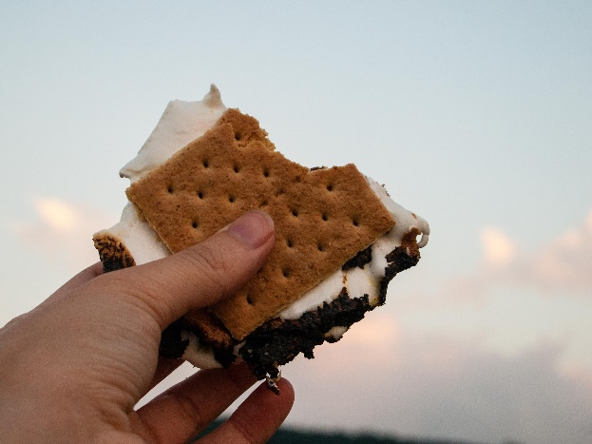
THEN COMES THE CHOCOLATE
Chocolate bar is placed on a graham cracker
Then the marshmallow is placed on the chocolate
Use the top graham cracker to get the marshmallow off the stick
Enjoy!
Notes:
Chocolate is the last ingredient.

Slide 22
Would anyone like to make a S’more
Questions?
Notes:
Does anyone have any questions

Slide 23
Kathy Babbitt President
The G.I.F.T. program from BABBITTS, INC. Uniting families around a healthy dinner table Living gluten free does not have to be challenging, overly costly or time consuming.
kathybabbitt@thebabbitts.net
www.lovinglivingglutenfree.net
256-652-6056

